Slide 1
An Analysis of Foster Care and Adoption Trends in the United States
By Melanie Desroches

Slide 2
Objective Statement
01
What are we looking for? What is the point of this project?

Slide 3
How has the foster care system performed over time? What trends within foster care and adoption have occurred?

Slide 4
Some Background…

Slide 5
What is the U.S foster care system?
“Foster care is a temporary, court-monitored service provided by States to promote the safety, permanency, and well-being of children and youth. The Federal government supports State foster care services through program funding and legislation. Foster caregivers typically undergo licensing and training so that they are well-equipped to provide children and youth with shelter, support, and care.” from www.childwelfare.gov

Slide 6
How does the foster care system work?
A child gets placed into foster care if their parent or legal guardian is deemed unable to care for the child for whatever reason
Child Protective Services takes legal custody of the child and the child is put into a temporary placement with either a family member or a certified foster family
The parent/legal guardian goes to court, where it is determined what they need to do in order to regain custody of their child
If the parent/guardian does all of the things they need to do, they regain custody of their child
If they do not, the judge will terminate the parental rights and the child goes up for adoption

Slide 7
Obtaining the Data
02
Where did the data come from?

Slide 8
The Children’s Bureau
My data was collected from the US Department of Health and Human Services annual Adoption and Foster Care Analysis and Reporting System (AFCARS). Every year, each state reports their statistics on the foster care system and the data is compiled into the AFCARS.

Slide 9
About the Data…

Slide 10
Definitions
Served
In Care on September 30
This is an estimated count of all the children in foster care on the last day of the FFY. An individual child is included in the count for each year for which he or she is in foster care on the last day.
This is an estimated count of all children who were in the public foster care system during the FFY. This number is the sum of two mutually exclusive groups of children: the children who are already in care on the first day of the fiscal year (as of October 1) and the children who enter foster care during the year. An individual child is counted only once for each year.
Entered
This is an estimated count of all children who entered foster care during the FFY. An individual child is counted only once for each year, even if the child entered, exited and reentered care during the year. If an individual child entered in one year and then exits and re-enters in a subsequent year, he or she is included in the count of entries for both years.

Slide 11
More Definitions
Exited
Waiting for Adoption
This is an estimated count of all children who exited foster care during the FFY at the end of their most recent foster care episode. An individual child is counted only once for each year, even if the child exited, re-entered and exited again during the year.If an individual child exited care in one year and then re-enters and exits again in a subsequent year, he or she is included in the count of exits for both years.
This is an estimated count of all children who are waiting to be adopted on the last day of the FFY. An individual child is included in the count for each year in which he or she is waiting to be adopted on the last day. Children waiting to be adopted include children with a goal of adoption and/or whose parental rights have been terminated. The “waiting” population excludes children who have a goal of emancipation.
Parental Rights Terminated
Adopted
This is an estimated count of all children in care on the last day of the FFY whose parental rights have been terminated and who are waiting for adoption. An individual child who has these characteristics on the last day of the year is counted only once for that year.
This is an estimated count of all children adopted with public child welfare agency involvement during the FFY. An individual child is counted only once for each year, even if (in rare cases) the child was adopted multiple times during the year. In cases when an individual child is adopted in one year and then adopted again in a subsequent year, he or she is included in the count of adoptions for both years.

Slide 12
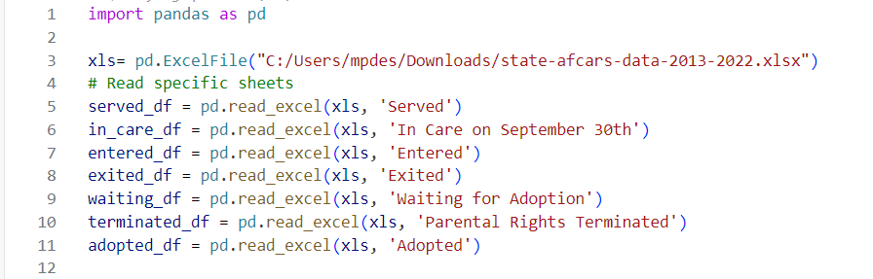
The Code:

Slide 13
Data Cleaning
03
Converting the Excel file into a dataframe that can be used for analysis and modeling

Slide 14
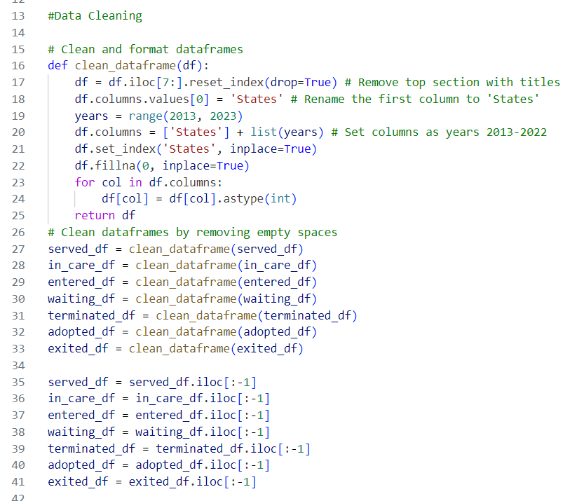
Remove Whitespace and Reformat
Any whitespace was removed from the top and bottom of each data frame
The States were set as rows and the columns were set as the years 2013-2022. This way each value in the data frame represents the total number of children from each state for each year

Slide 15
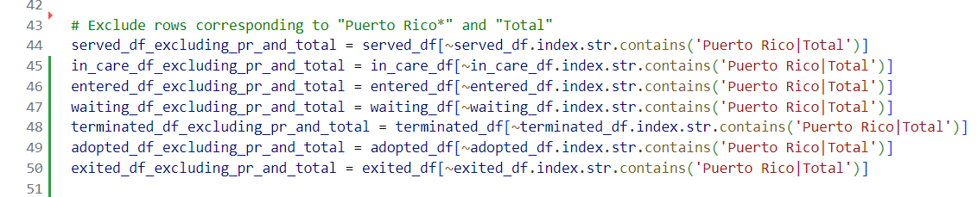
Removing Rows
I decided to remove the rows Puerto Rico and Totals for each data frame. I removed Puerto Rico because the reports only included values for 2018-2022. This seemed like too little data. Because I removed Puerto Rico, I also removed the Totals row since the information was now inaccurate.

Slide 16
Initial Data Visualization
04
Let’s take a closer look at the data

Slide 17
How I created my Visualizations
To create the plots, I created a new dataframe with the totals for each year across all states. I did this for each data frame and then, using matplotlib.pyplot, I created plots for each attribute of the foster care system.
To create the maps, I downloaded the TIGER/Line Shapefiles from the US Census Bureau website. Then using the geopandas library, I was able to merge the us map with my data frames and then generate a map.

Slide 18
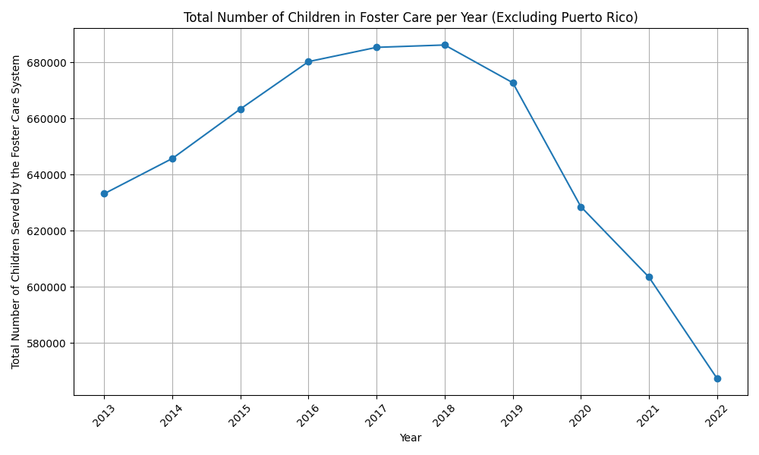
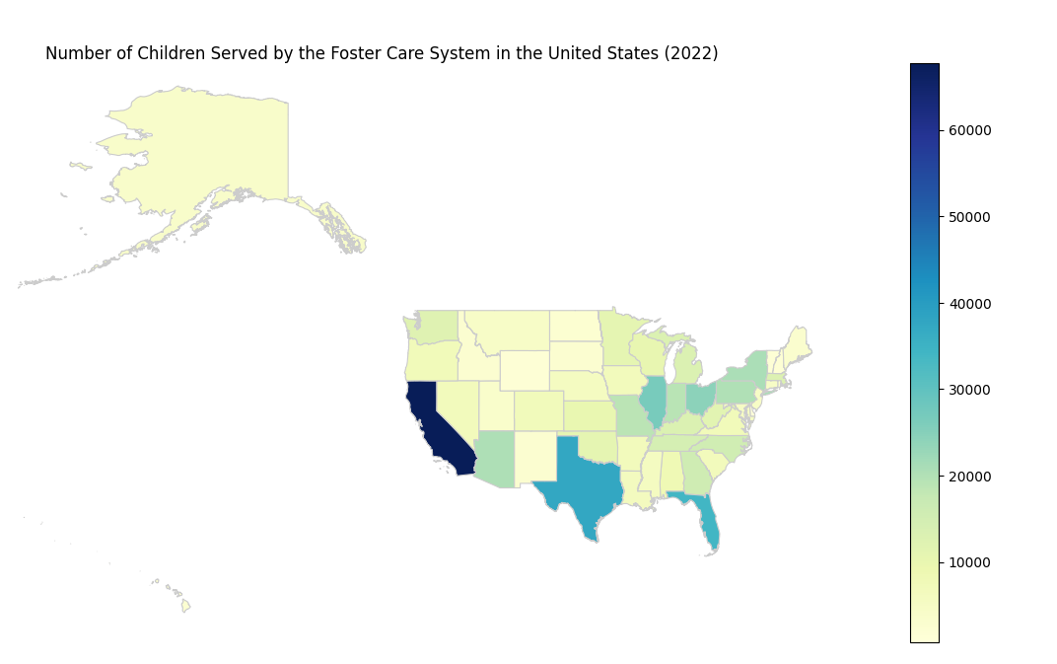
Children in Foster Care Over the Years

Slide 19
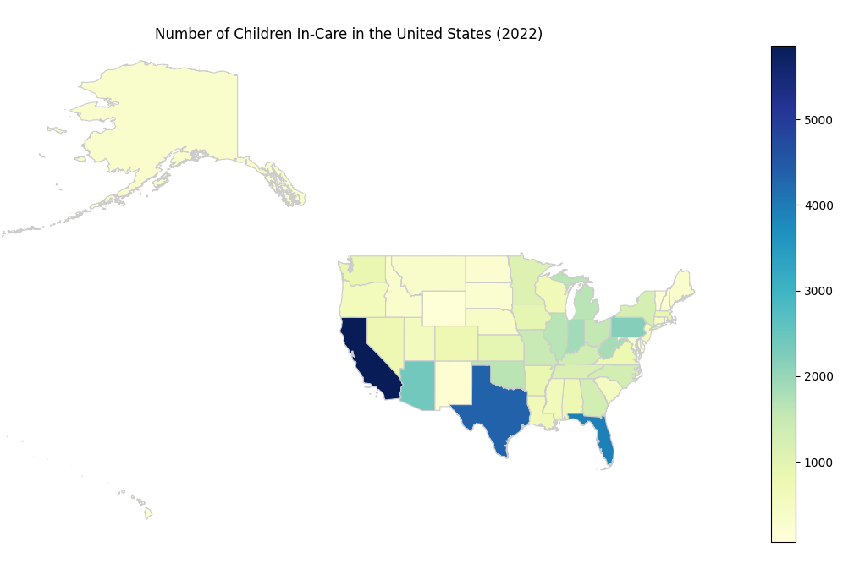
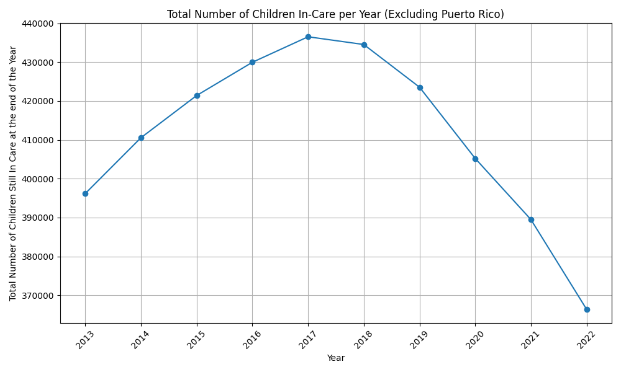
In-Care

Slide 20
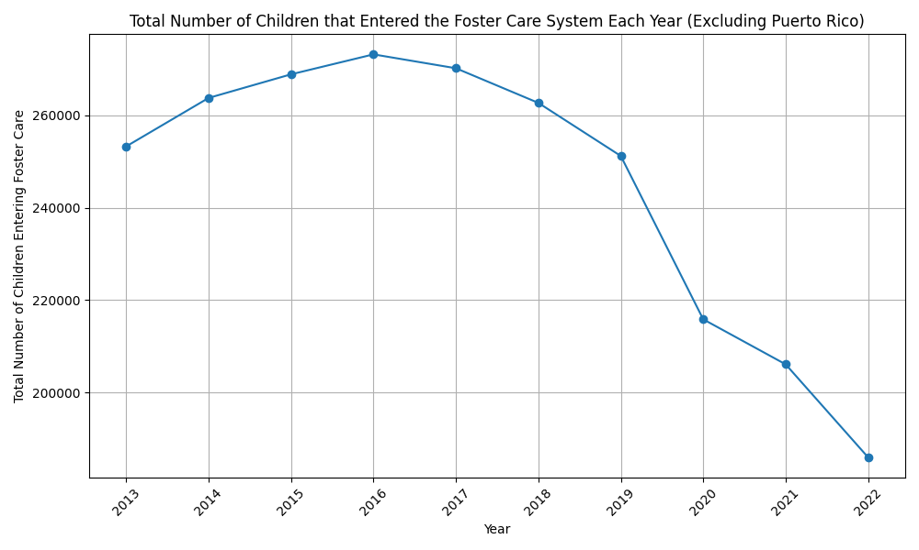
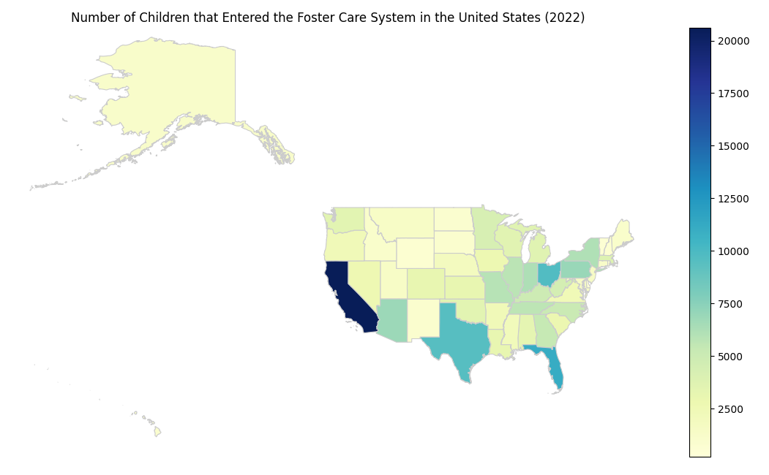
Entered

Slide 21
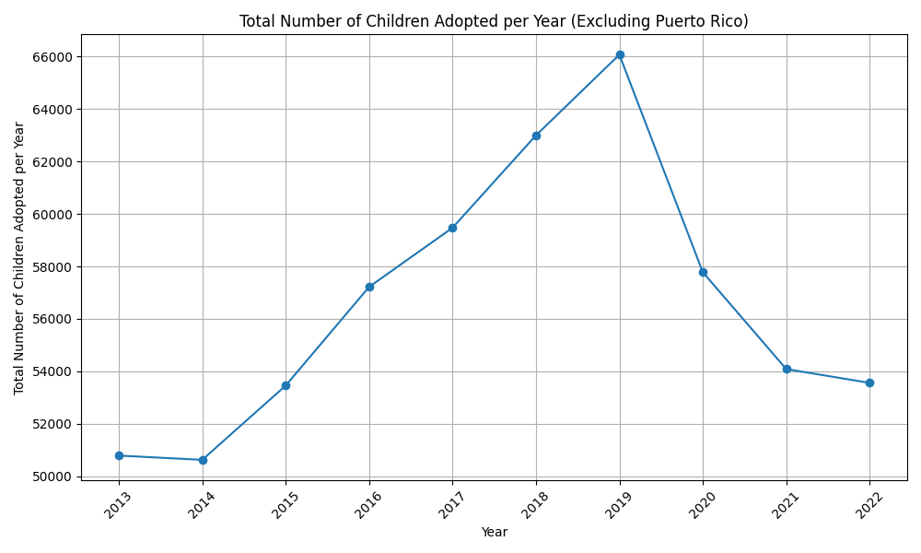
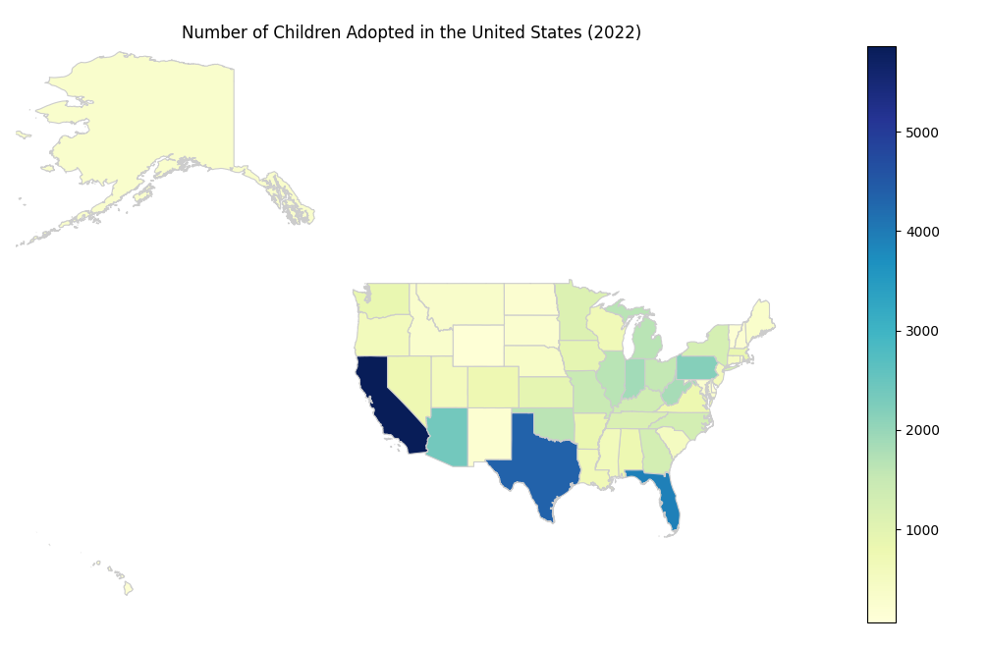
Adopted

Slide 22
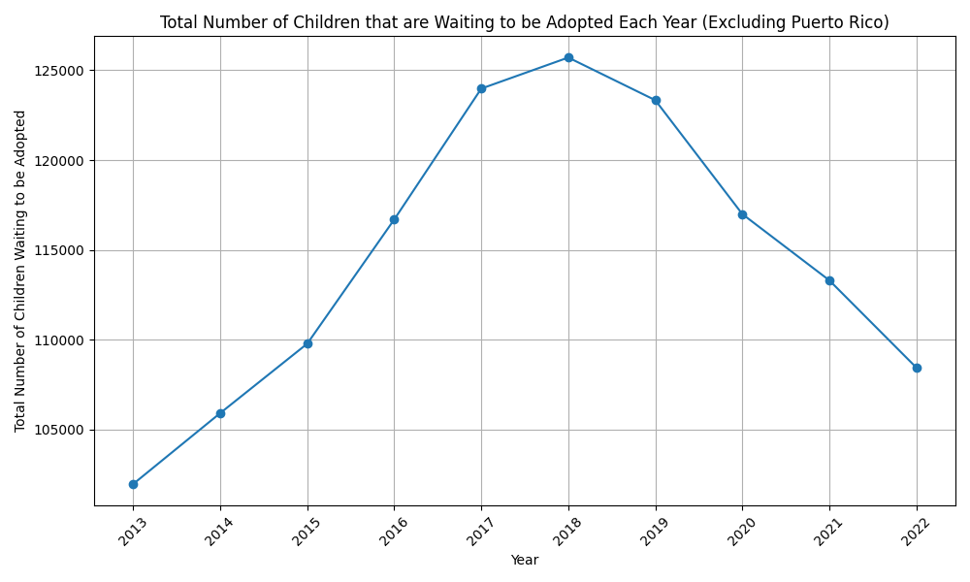
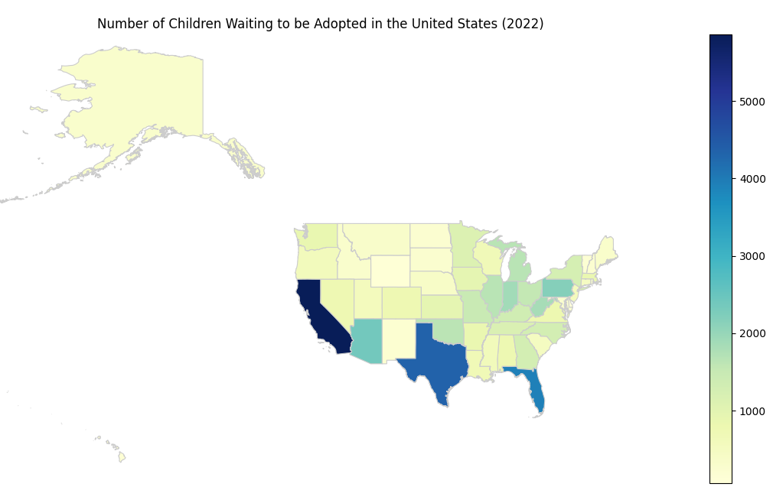
Waiting to Be Adopted

Slide 23
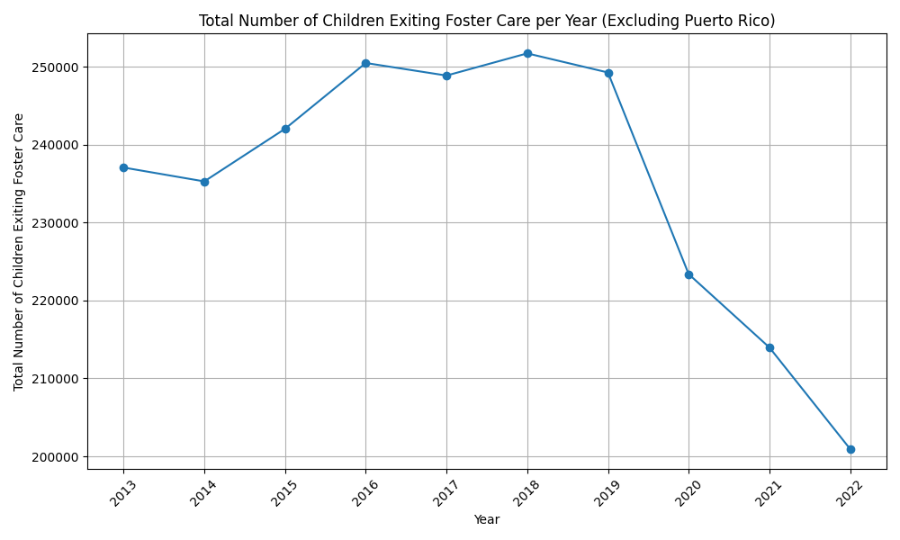
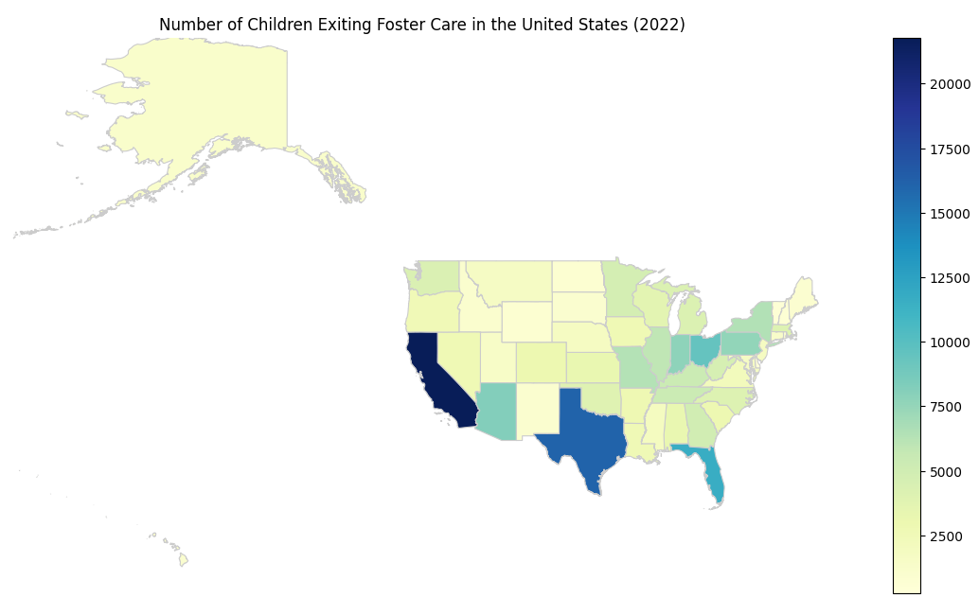
Exited

Slide 24
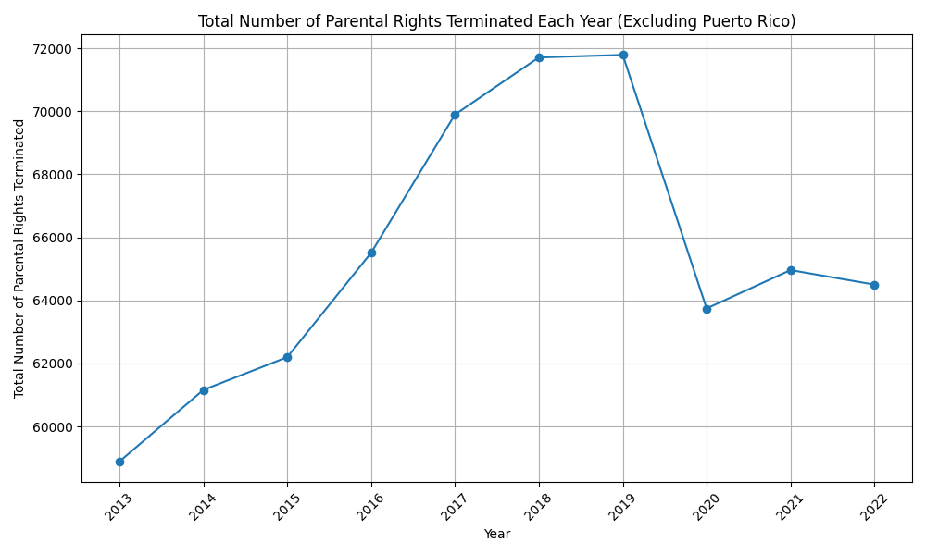
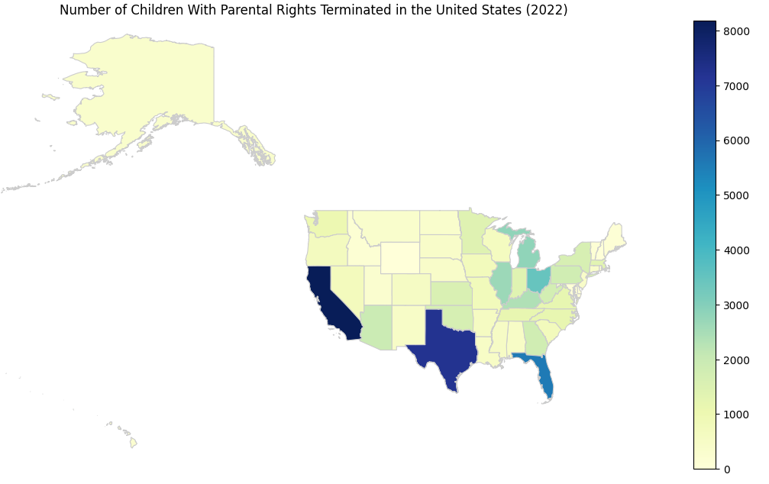
Children Whose Parental Rights were Terminated

Slide 25
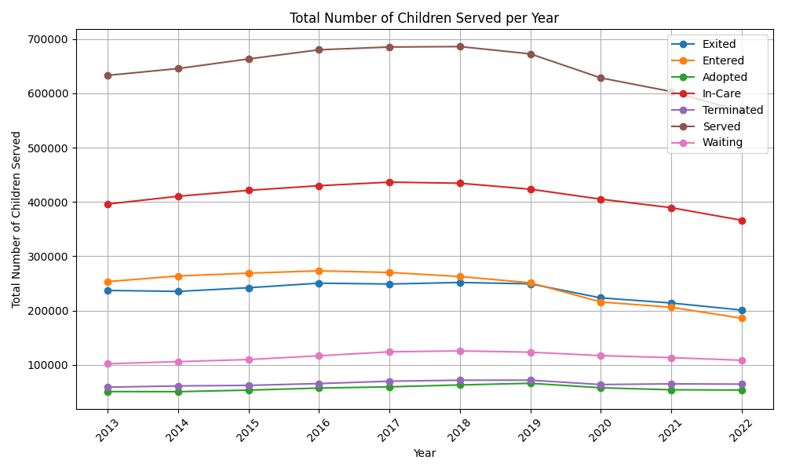
Totals

Slide 26
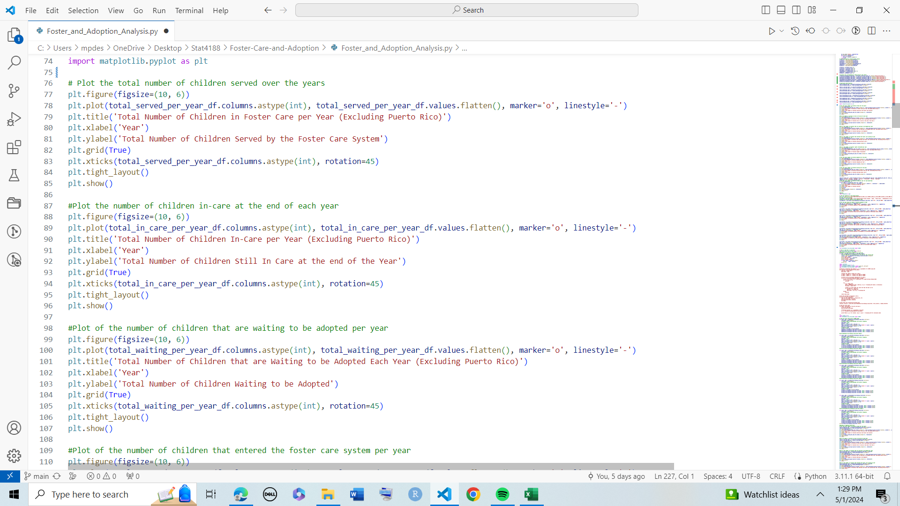
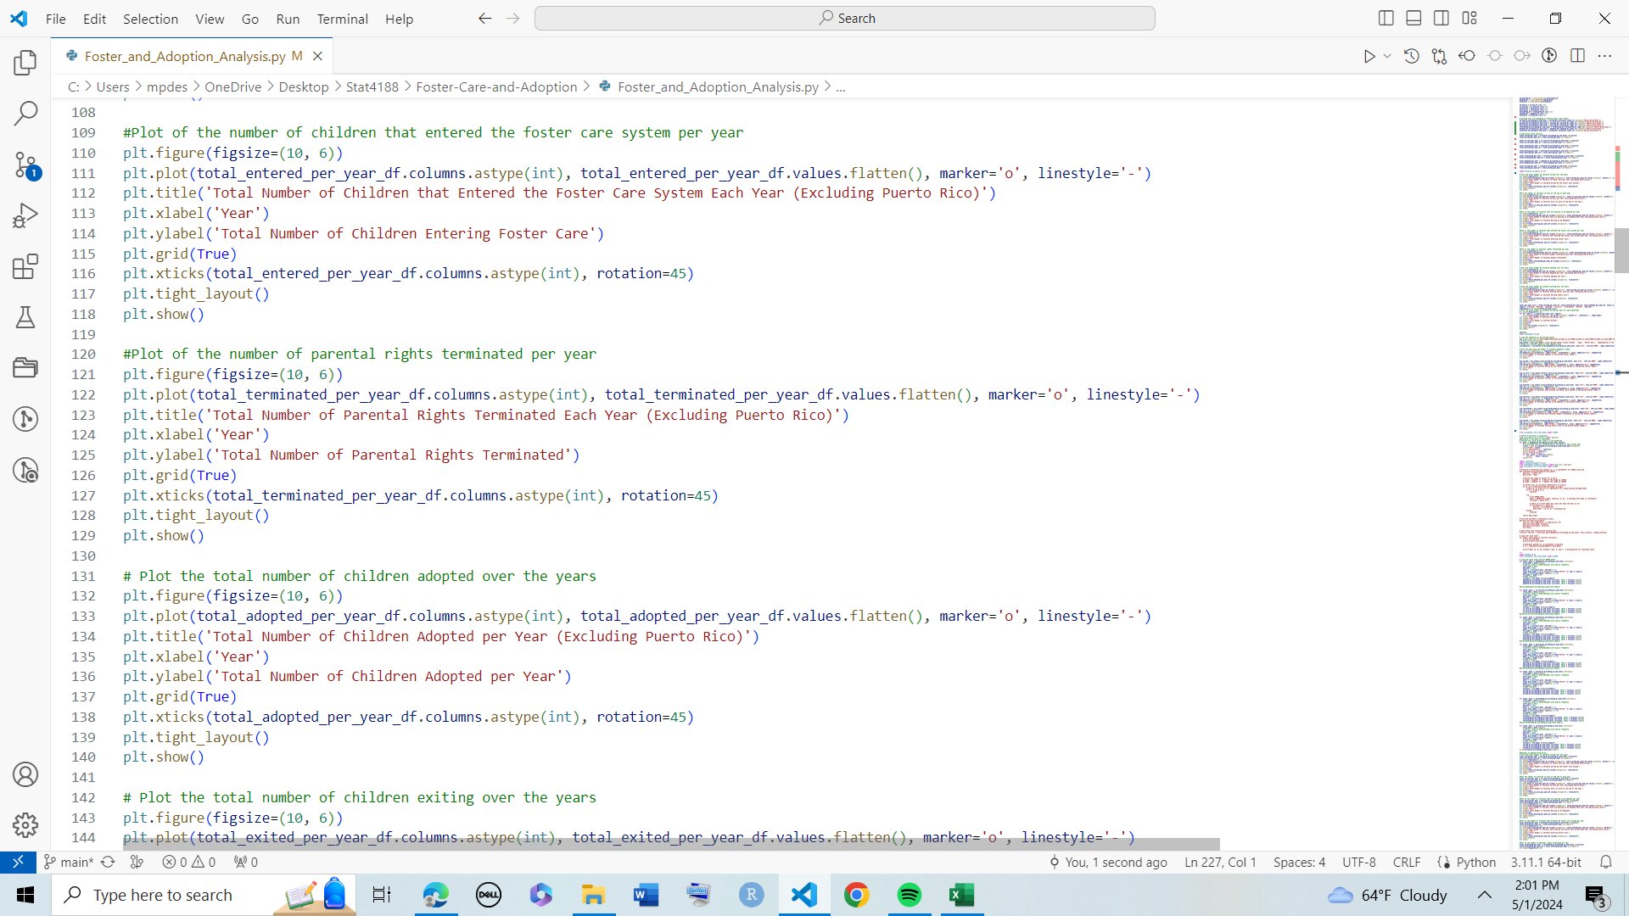
The Code for the Plots:

Slide 27
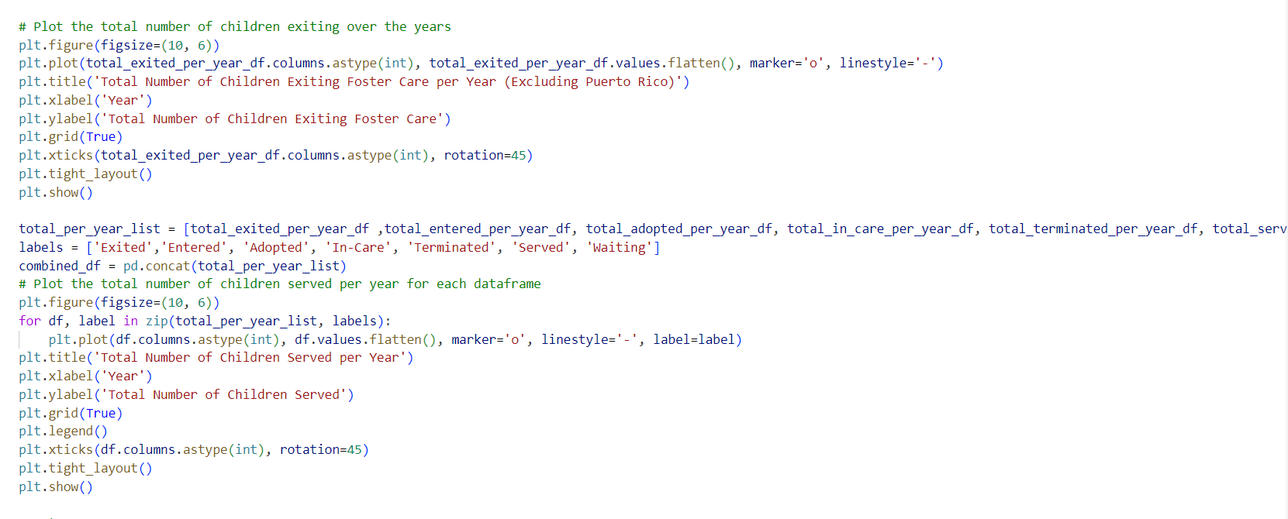
More Code:

Slide 28
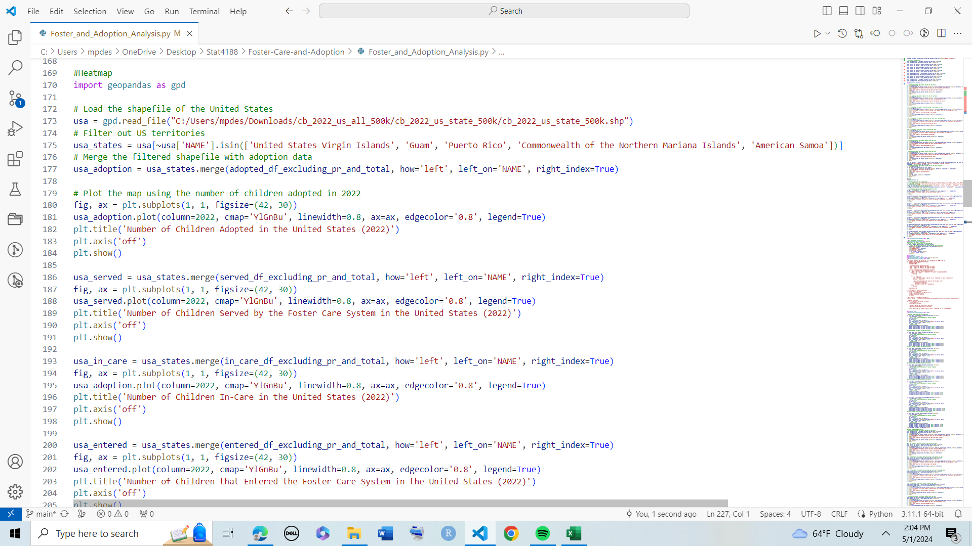
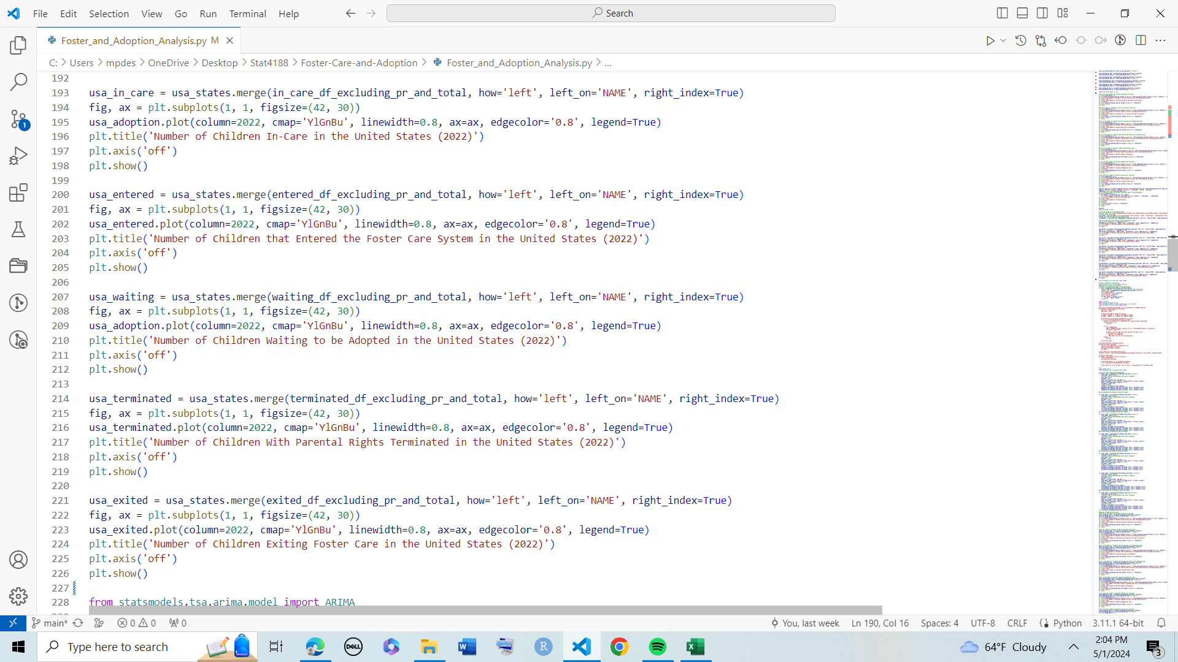
The Code for the Heatmaps:

Slide 29
Data Modeling
05
ARIMA and K-Means Clustering

Slide 30
ARIMA
Since the data is collected over time, I needed to perform a time series analysis in order to predict trends over future years. For this reason, I chose to create an AutoRegressive Integrated Moving Average (ARIMA). To do this, I first needed to make sure the data was stationary using the adfuller test from the statsmodels.tsa.stattools library. Once I did this, I was able to construct the model and add the predictions to my data frames.

Slide 31
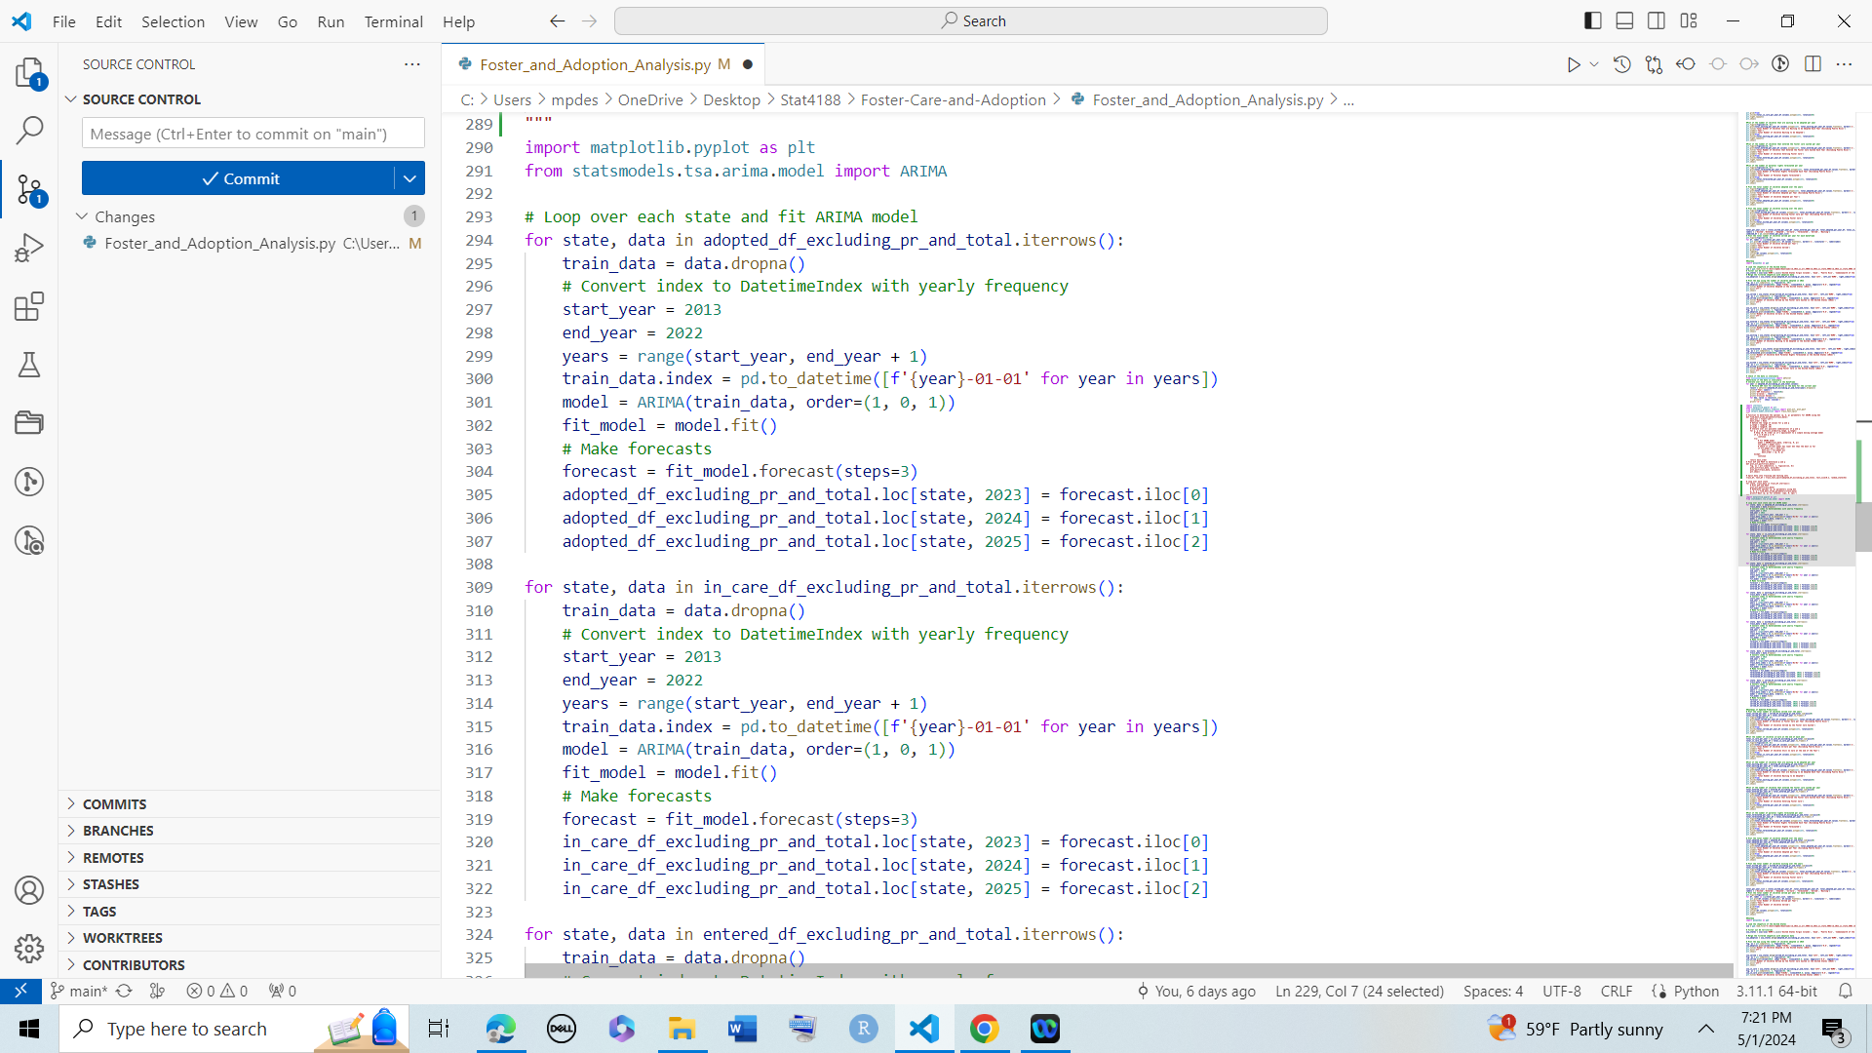
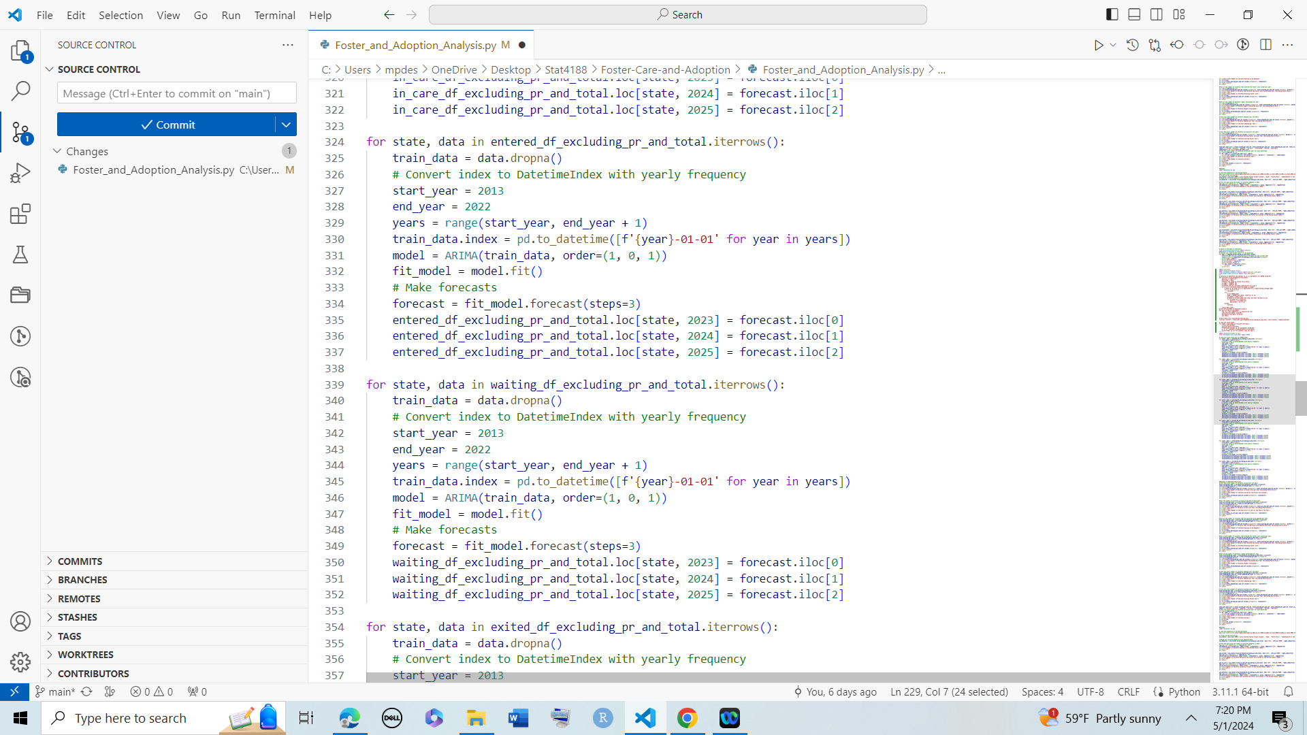
The Code for ARIMA:

Slide 32
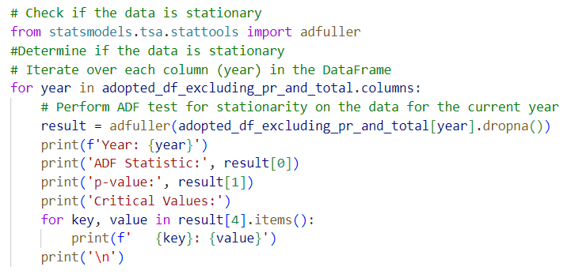
Checking the Data is Stationary

Slide 33
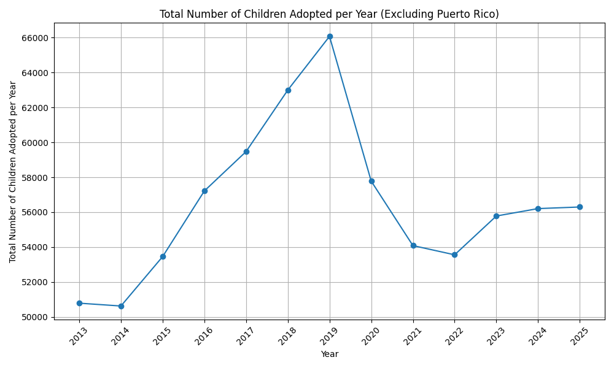
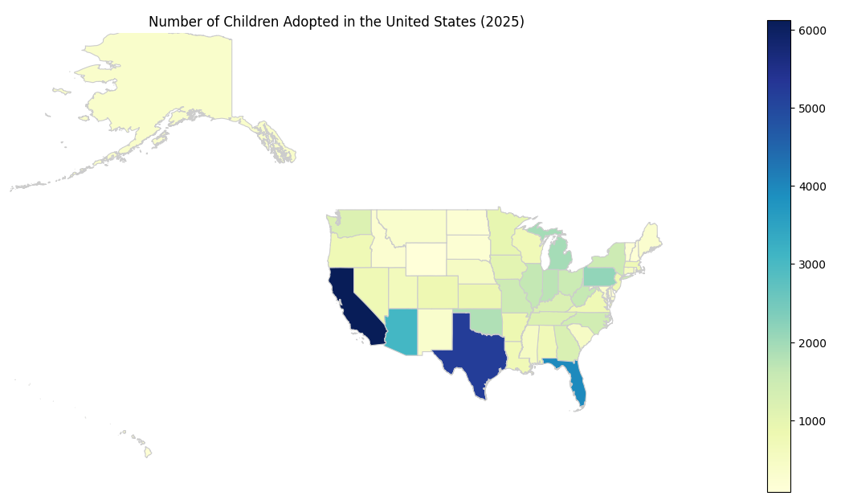
Adopted Predictions

Slide 34
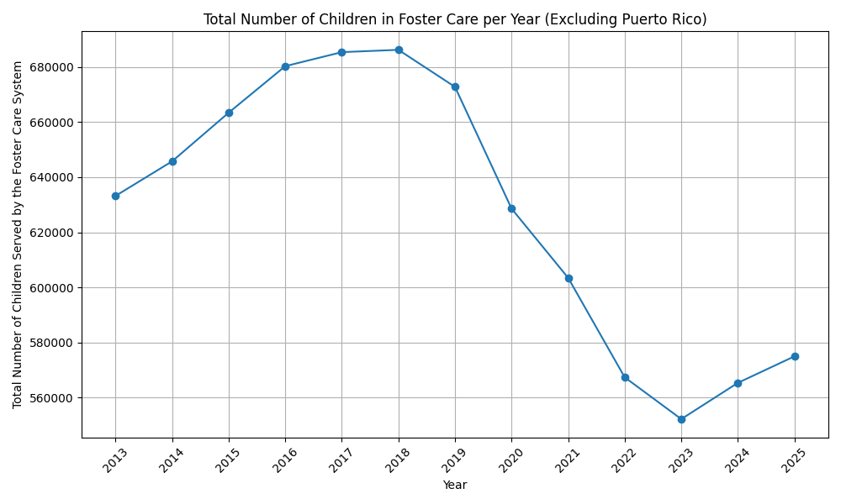
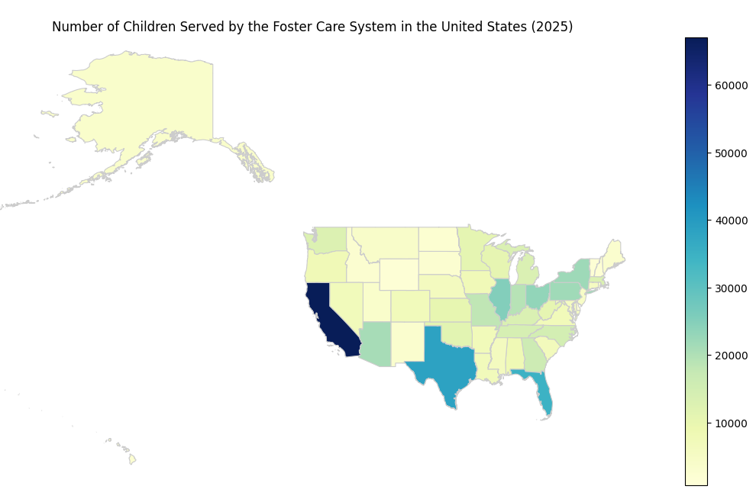
Served Predictions

Slide 35
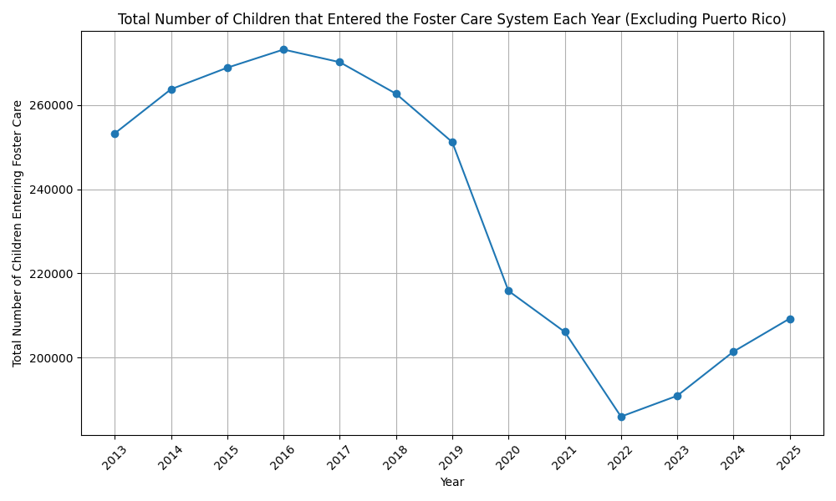
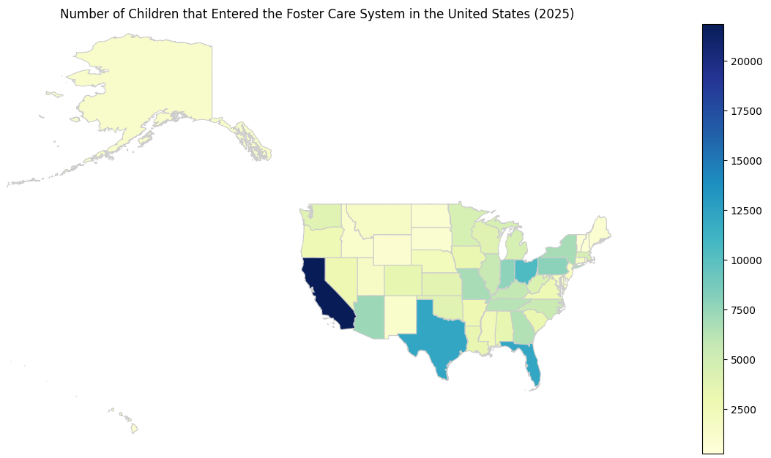
Entered Predictions

Slide 36
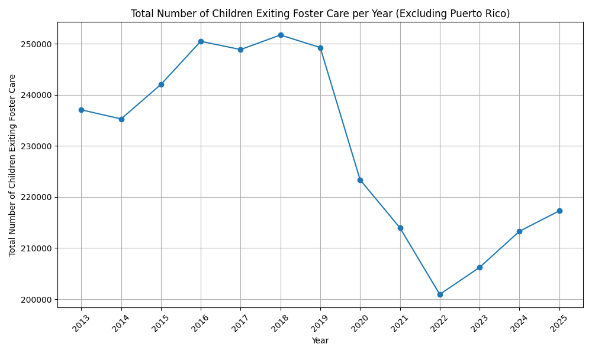
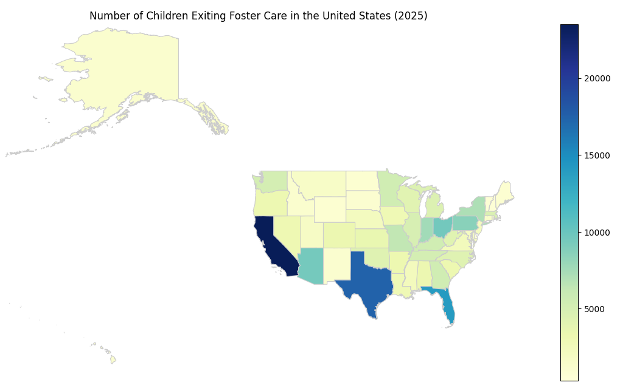
Exited Predictions

Slide 37
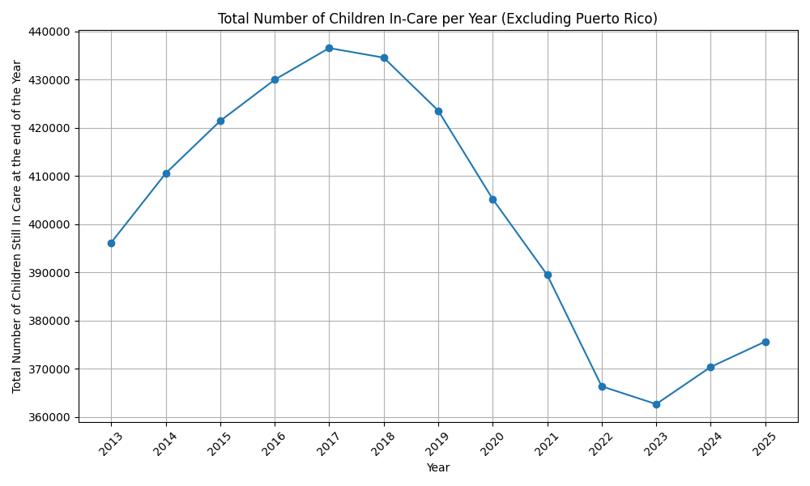
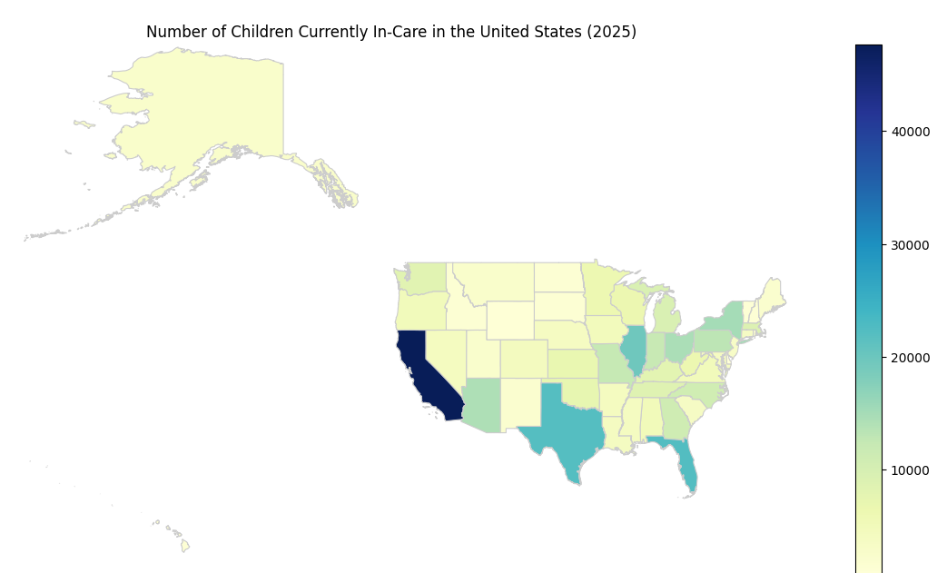
In-Care Predictions

Slide 38
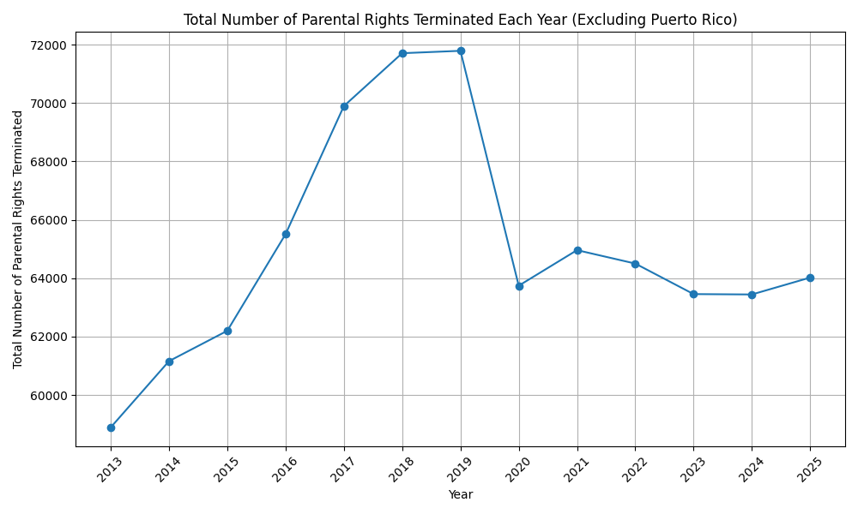
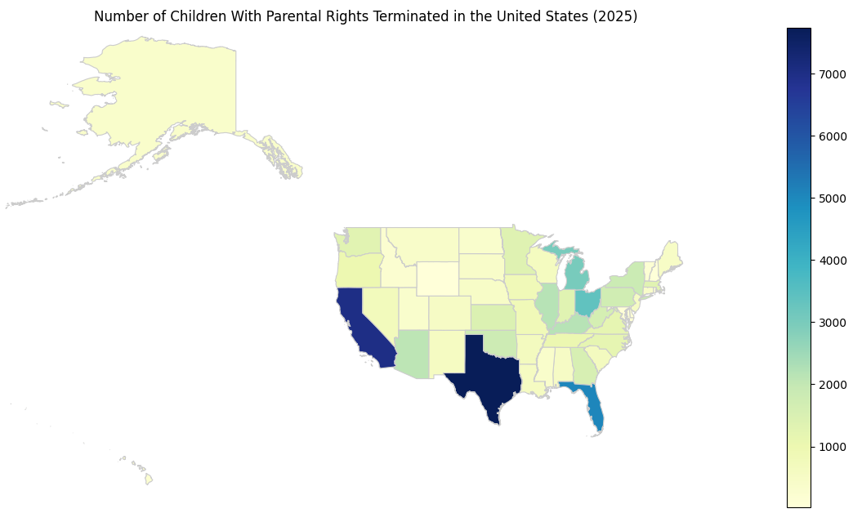
Terminated Predictions

Slide 39
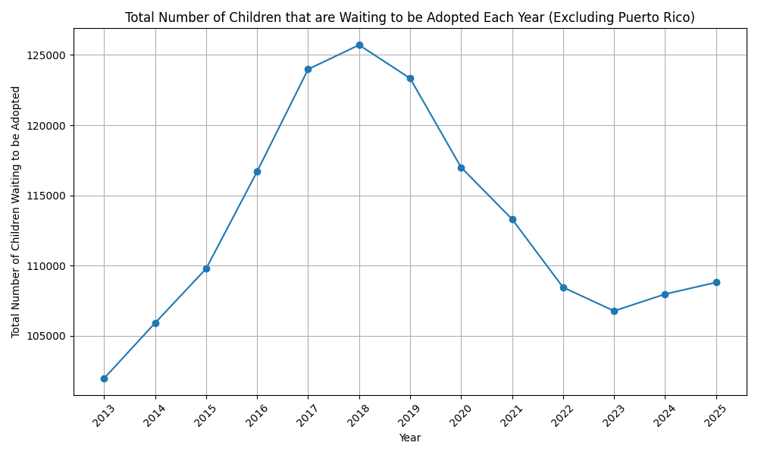
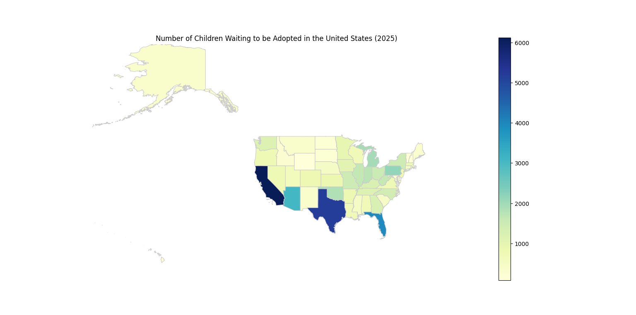
Waiting to Be Adopted Predictions

Slide 40
K-Means Clustering
After seeing these predictions, I wondered how I could compare the states to each other. Thus, I created a K-means clustering algorithm to combine all the factors and compare them across states. I created the clusters using K Means from the sklearn.cluster and StandardScalar from sklearn.preprocessing. Using the same technique as before, I was able to map out the clusters with geopandas.

Slide 41
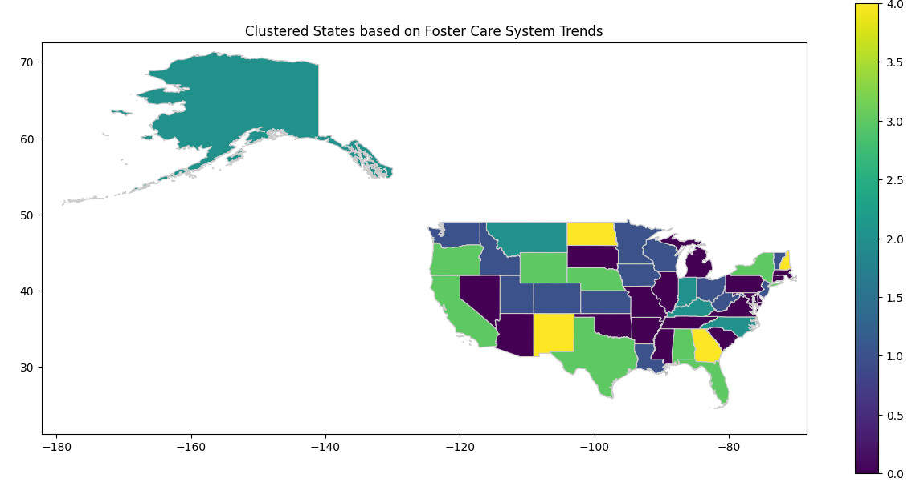
Clusters

Slide 42
Clusters
Cluster 0: MA, CT, PA, VA, MD, TN, SC, MS, AR, OK, MO, MI, SD, AZ, NV
Cluster 1: VT, NJ, WV, OH, WI, MN, IA, KS, CO, UT, ID, WA, LA
Cluster 2: NC, KY, IN, MT, AK, HI
Cluster 3: NY, FL, AL, TX, NE, WY, OR, CA
Cluster 4: ME, NH, GA, ND, NM

Slide 43
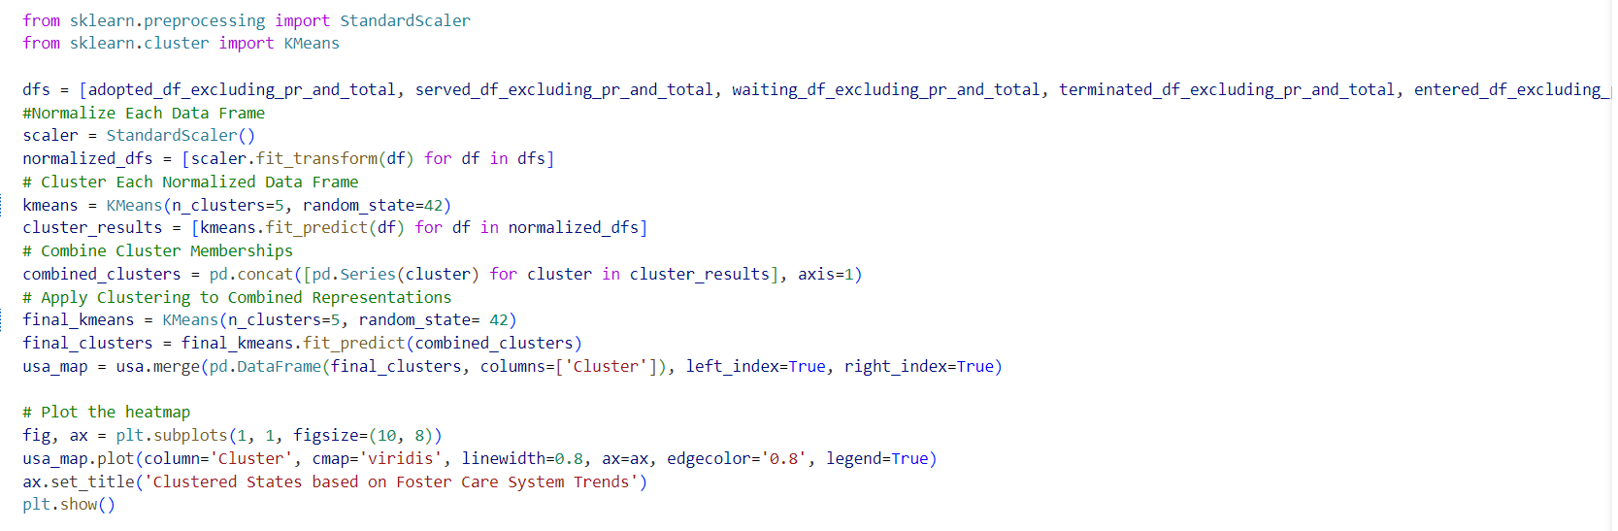
K-Means Code:

Slide 44
Analysis
06
What did we learn?

Slide 45
Notable Shift in the Data
When performing the preliminary data visualizations, I noticed for many of the graphs, the data peaks in either 2018 or 2019. There are two possible reasons for this. The obvious possibility is the effects that Covid had on the foster care system. Another possibility that could have caused the data to peak at 2018 and then start to decrease is the introduction of the Family First Prevention Services Act, which increased state funding for foster care families and child-protective services (excluding group homes).

Slide 46
Analyzing the Clusters
Based on the clusters, states that had similar trends were clustered together. To learn more about the clusters, I decided to calculate the cluster centers to see what else I could learn from them.

Slide 47
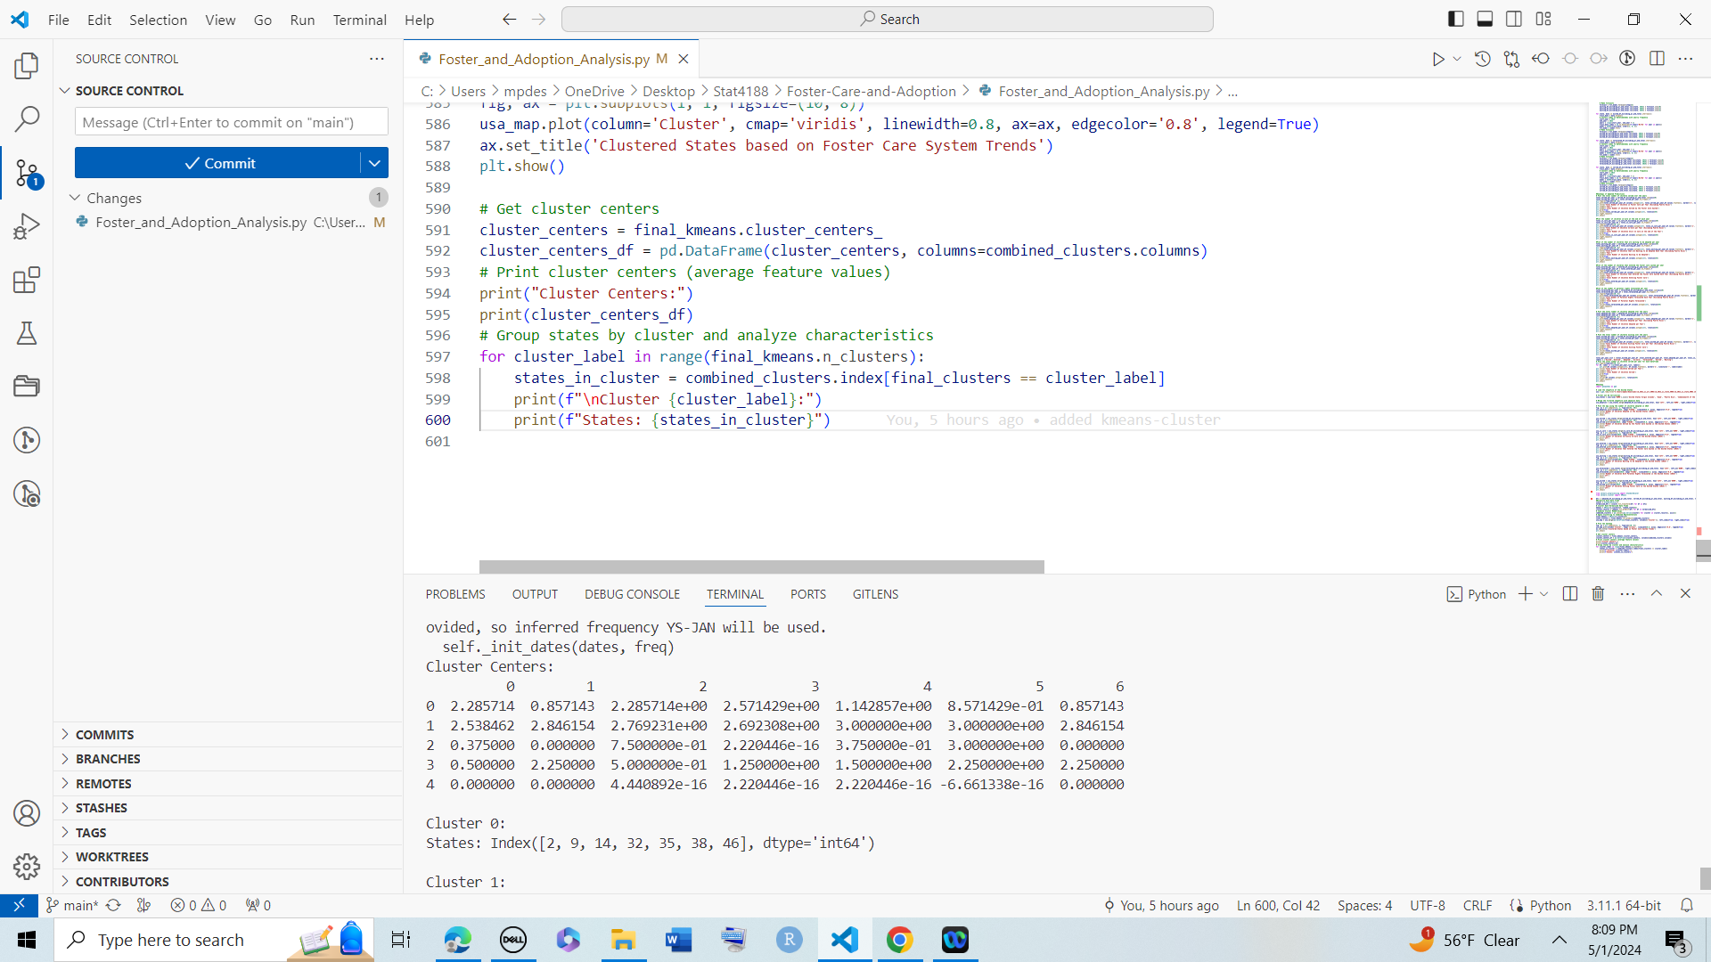
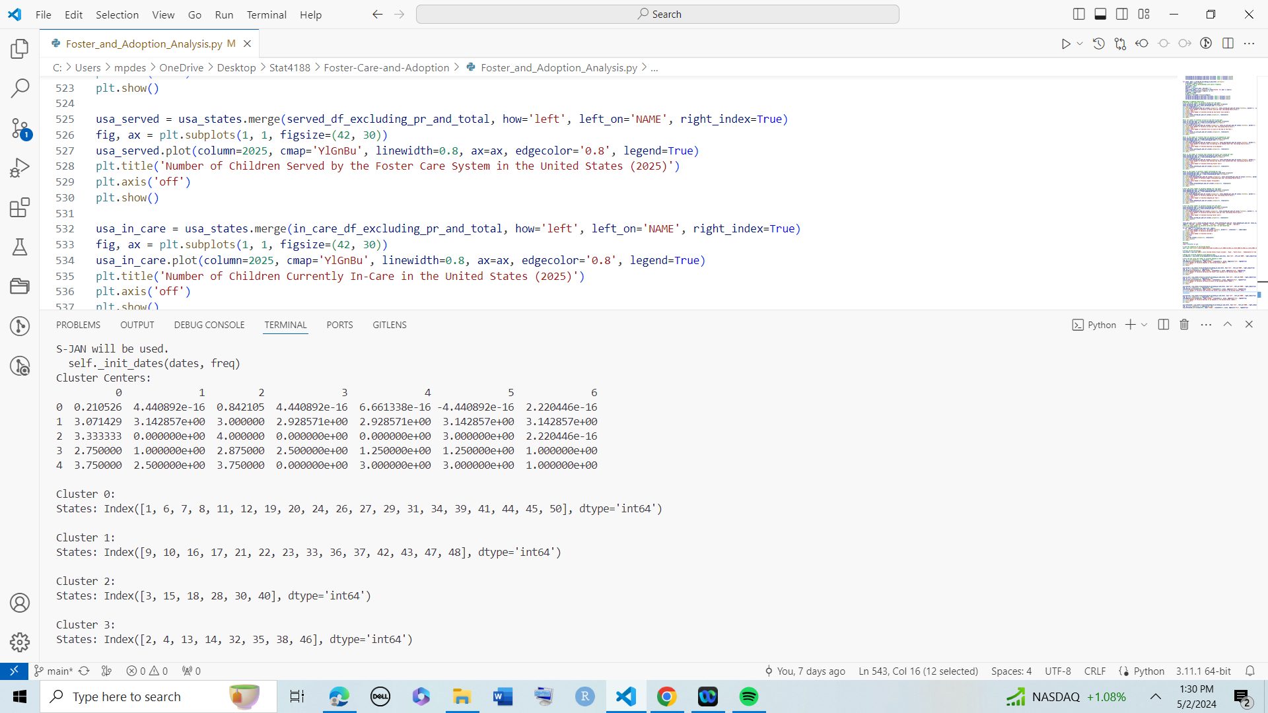
Analyzing Cluster Centers

Slide 48
Understanding the Clusters
Cluster 0: This cluster has relatively low adoption rates and children waiting to be adopted but very few children served or exited. Termination rates are also low. This suggests that states in this cluster may have minimal activity in the foster care system.
Cluster 1: This cluster has high values for all features of the foster care system. This cluster represents states with high activity levels in the foster care system.
Cluster 2: This cluster has high adoption rates and children waiting to be adopted but few children served or entered. This could indicate that children move through the foster care system very fast.
Cluster 3: This cluster has moderate adoption rates, children served, children entered, and children exited. Waiting lists are moderate, and termination rates are relatively low. This cluster represents states with moderate activity levels in the foster care system.
Cluster 4: This cluster has high adoption rates, children served, children entered, and children exited, but very few children waiting to be adopted. Termination rates are also low. This suggests that states in this cluster have high levels of activity in the foster care system and children are able to be adopted very fast.

Slide 49
Limitations or Sources of Error
Due to the dramatic effects of Covid, I worry that the ARIMA model may expect that trend to continue
Small sample size
Some states may have seemed to stand out simply because they have a larger population and therefore have more children in their foster care systems.

Slide 50
Thanks!
GitHub Repository: https://github.com/melpd/Foster-Care-and-Adoption/tree/main

Slide 51
Credits
Presentation Template: SlidesMania
https://capacity.childwelfare.gov/about/cb-priorities/family-first-prevention
https://www.acf.hhs.gov/cb/research-data-technology/statistics-research/afcars
https://www.analyticsvidhya.com/blog/2021/10/a-comprehensive-guide-to-time-series-analysis/
https://www.analyticsvidhya.com/blog/2021/10/a-comprehensive-guide-to-time-series-analysis/
https://adoption.org/foster-care-work/#:~:text=CPS%20searches%20for%20a%20home%20whose,foster%20parent%20becomes%20the%20custodian%20guardian.&text=CPS%20searches%20for%20a,becomes%20the%20custodian%20guardian.&text=for%20a%20home%20whose,foster%20parent%20becomes%20the
https://www.childwelfare.gov/topics/permanency/foster-care/
https://www.census.gov/geographies/mapping-files/time-series/geo/tiger-line-file.html

